Slide 1


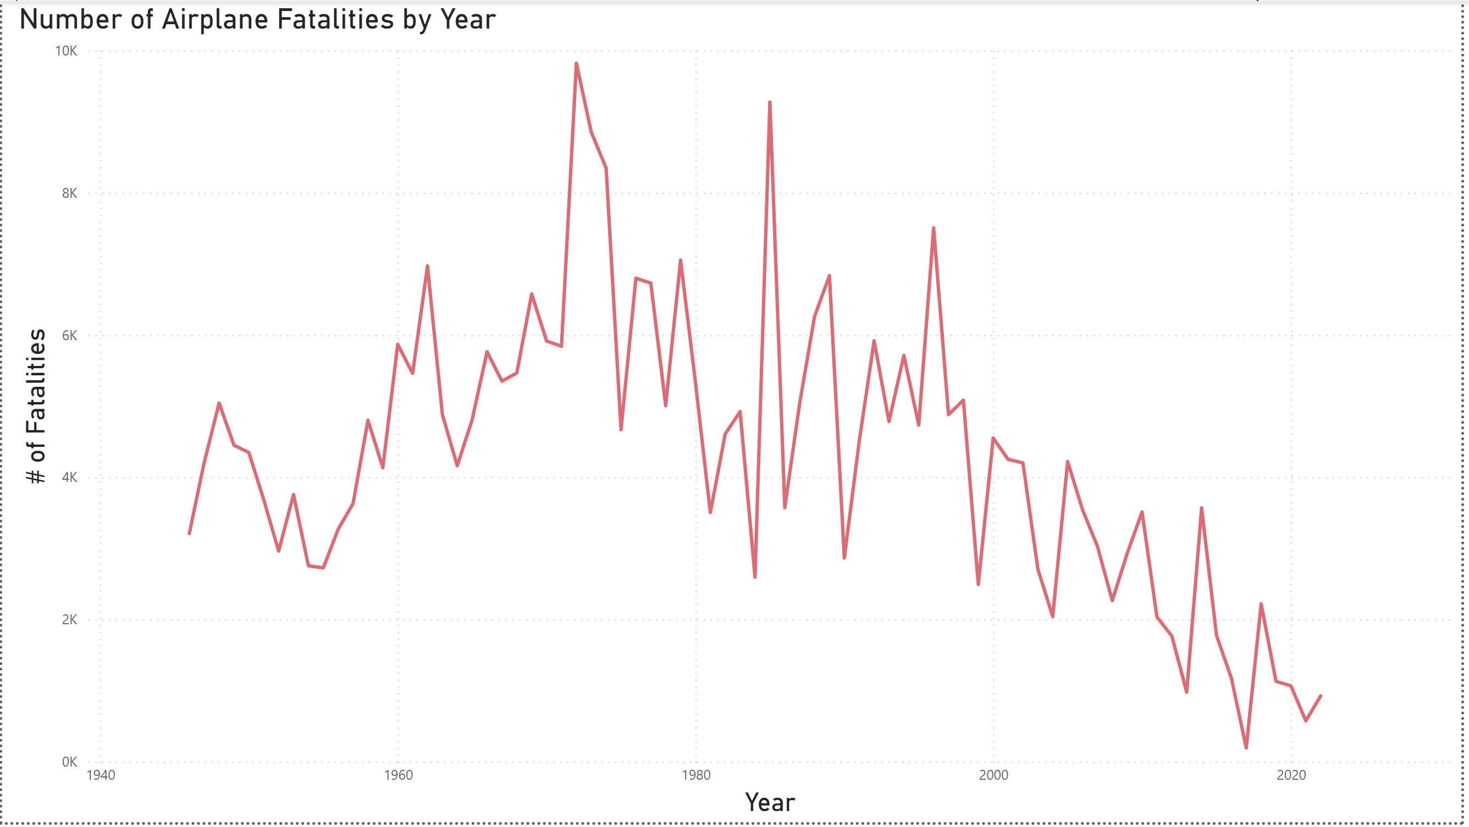



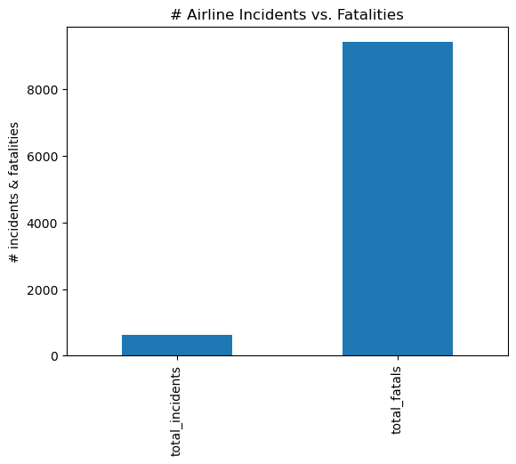

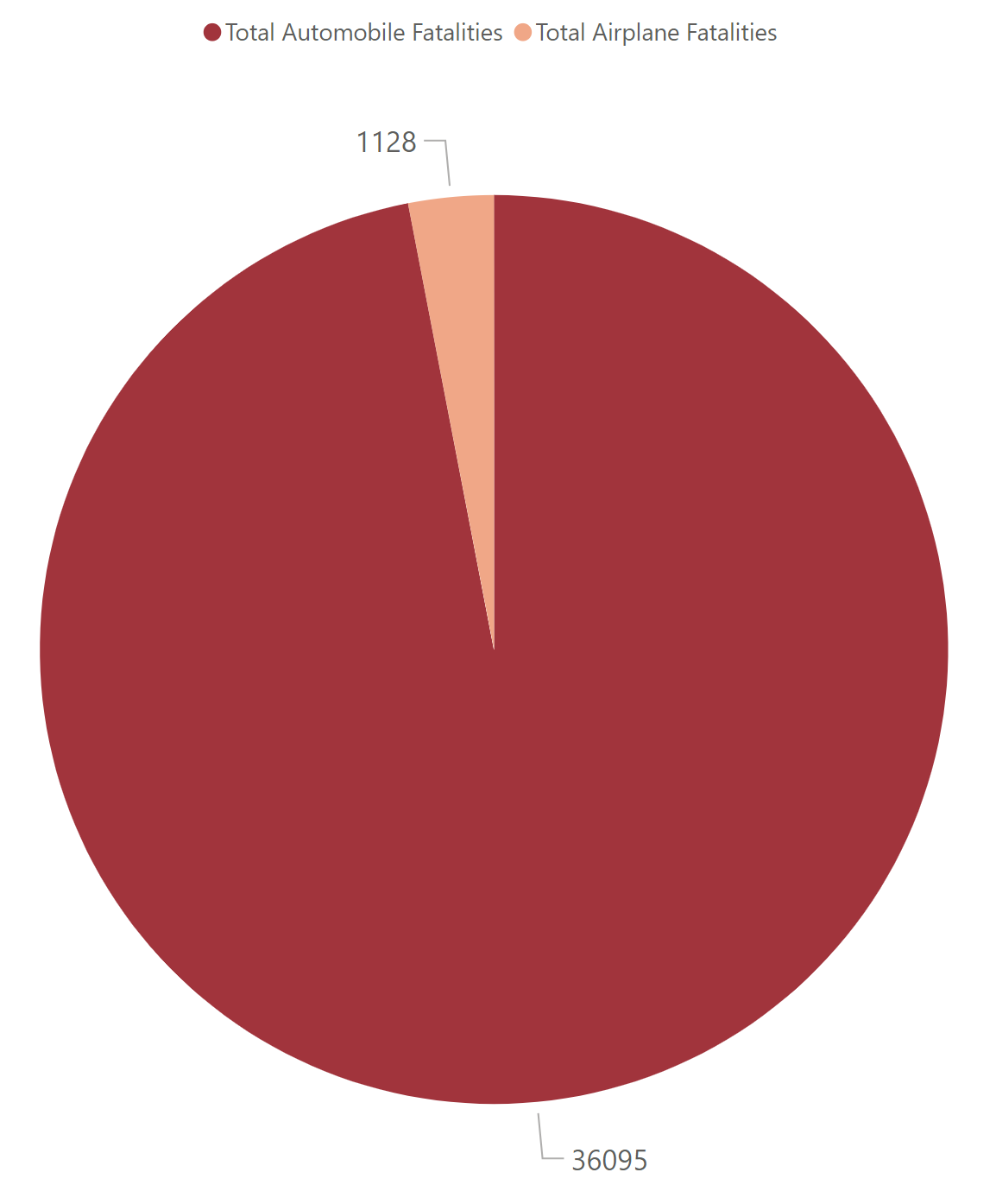
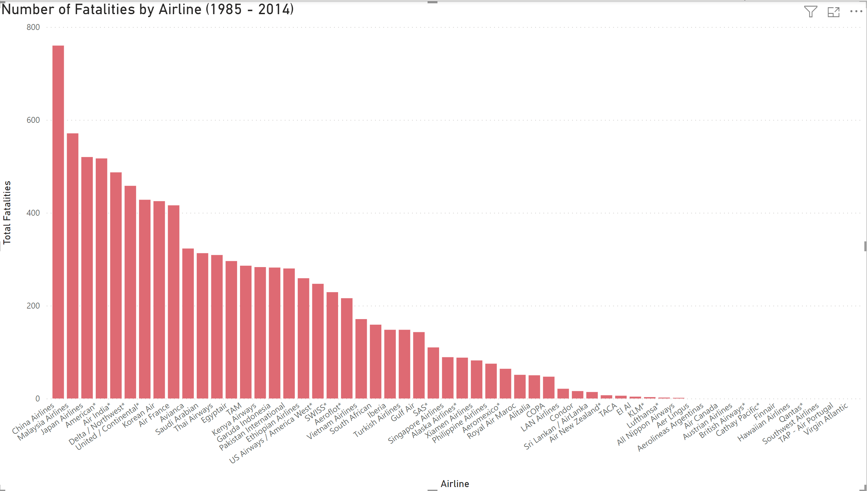

Infographic Resume
Safer Form of Travel: Airplane
Informative Infographic by Air Airlines
Email:
Info@airairlines.com
Website
airairlines.com
Phone
+1234-567-8910
Scan below for more info:
Airplane Deaths Trending Downward
Airplane is #1 safest way to travel
4130%
More Car Accidents than Airline Accidents in 2019
Explore the World
The airplane is one of humankind’s greatest inventions. Explore more why it is a safe form of travel to get anywhere on the beautiful globe.
Share the love for airplane travel and airplane safety by using
#skysafety
Far Less Fatalities in an Airplane
Automobile Deaths in 2019
Airline Deaths in 2019
17 million
Real Numbers!
Breakdown by Airline
kilometers traveled by plane where 1 death occurs
The odds are in your favor!
Come fly with us and check out the most convenient, safest, and luxurious form of travel at Air Airlines
The right visual shows 30 years of each airline's deaths
These numbers are significantly lower than automobile companies' deaths
Trust in your air travel as it is safer for you, your family, and employees

